Slide 1
ME 498 Final Project - Topic 2:
Automatic Identification of Graphene
Liu Hong, Dingyu Peng, Tyler Tran, Thomas Phelps

Slide 2
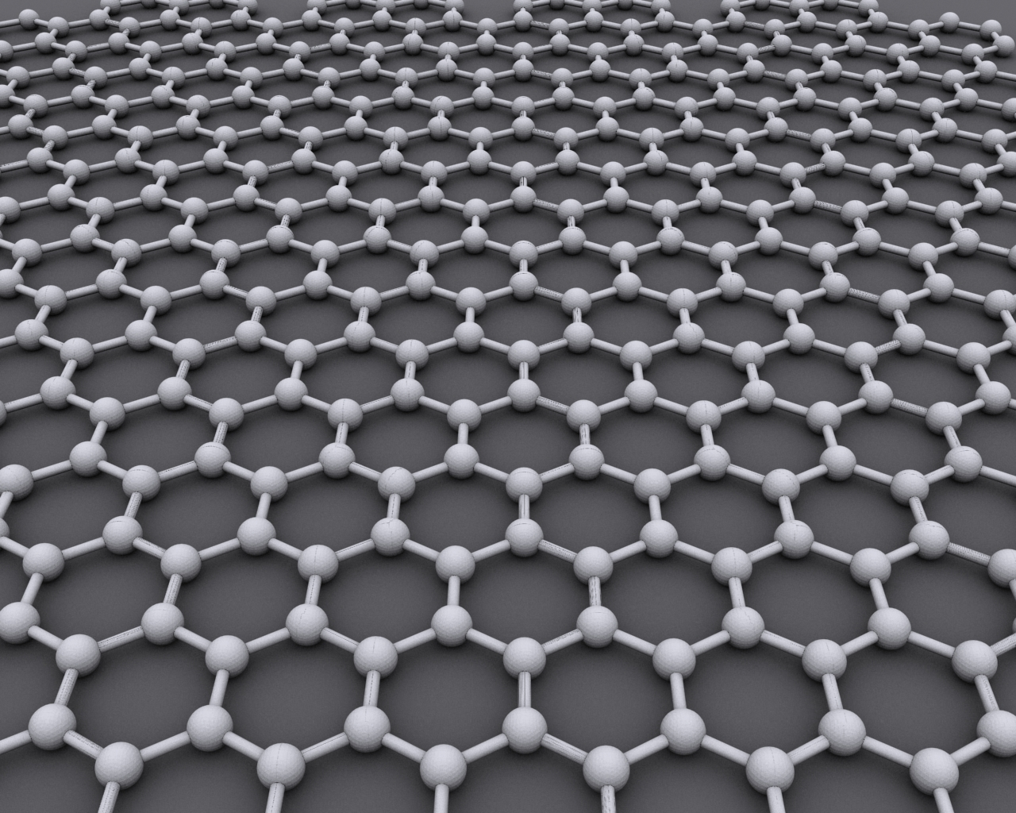
Introduction and Motivation
Graphene synthesis is a very promising field
Graphene is the strongest material ever tested
Graphene has one of the highest thermal conductivities
Graphene is nearly transparent
Graphene fabrication is very involved, so there is demand for finding a way to identify graphene in electron microscope images
By AlexanderAlUS - Own work, CC BY-SA 3.0, https://commons.wikimedia.org/w/index.php?curid=11294534
Notes:
Thomas

Slide 3
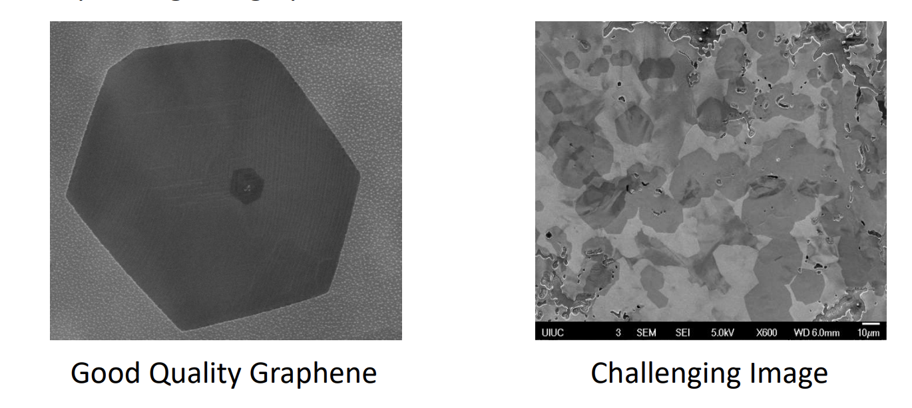
Problem Statement
Detect graphene surface coverage in SEM (scanning electron microscope) images to quantify the efficacy of different synthesis recipes.
Use the tool provided by the nanoMFG node to generate training data by manually determine the areas covered by graphene.
Develop machine learning algorithm to automatically scan SEM images to determine location and features of graphene.

Slide 4
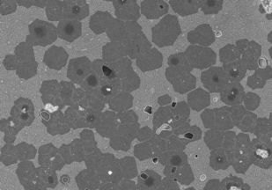
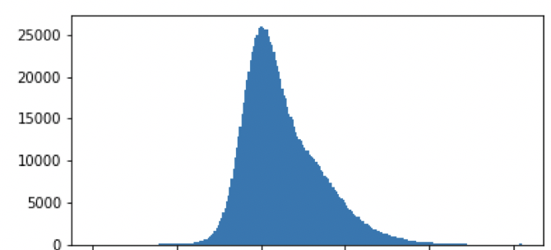
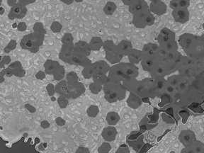
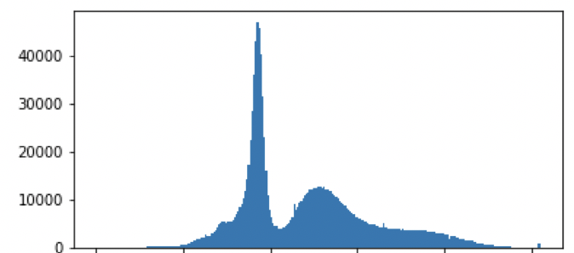
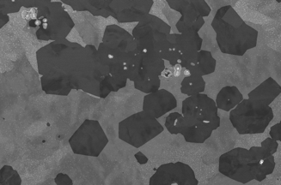
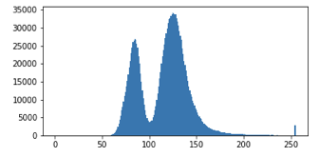
Formulation
Flatten grayscale pictures to see histogram
Discover that background and graphene color can be separated
Notes:
Liu

Slide 5
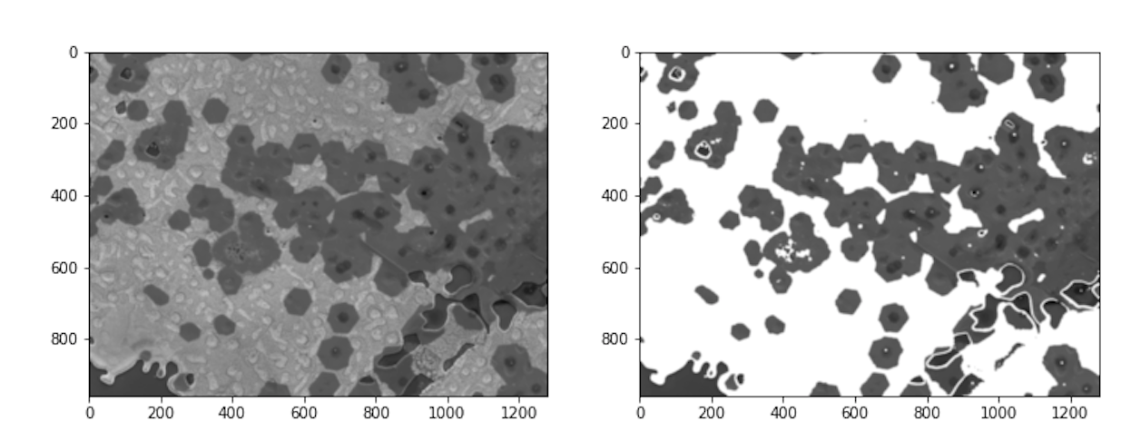
Feature Generation
Use provided tool to manually mask raw image
Use OpenCV imread function for image sliding of 8 by 8 pixel windows
Notes:
Dingyu

Slide 6
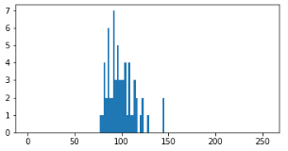
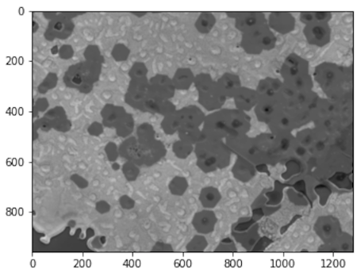
Feature Generation
127 features
Generate unit 8 rgb image from binary image.
Break the image into overlapping patches (50% overlap)
86 | 95 | 95 | 93 | 85 | 93 | 97 | 101
96 | 113 | 102 | 108 | 122 | 105 | 145 | 144
86 | 108 | 116 | 93 | 108 | 123 | 92 | 111
96 | 90 | 81 | 102 | 114 | 79 | 88 | 82
82 | 100 | 96 | 85 | 128 | 114 | 98 | 121
90 | 84 | 103 | 83 | 115 | 96 | 100 | 88
92 | 78 | 86 | 116 | 99 | 109 | 104 | 95
82 | 107 | 93 | 104 | 82 | 93 | 104 | 98
Notes:
Dingyu

Slide 7
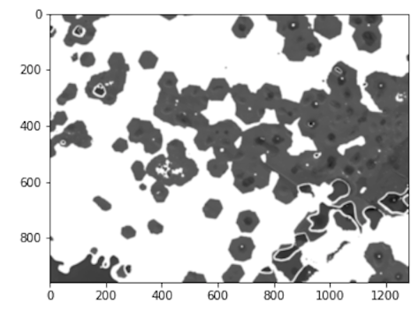
Label Generation
1
From binary image: If pixel is nonwhite=1, If not =0
If sum of patches <= 32, claim patch as graphene
Generate patches for sample and result
0 | 0 | 0 | 0 | 0 | 0 | 0 | 0
0 | 0 | 0 | 0 | 0 | 0 | 0 | 0
1 | 1 | 1 | 1 | 1 | 1 | 0 | 0
1 | 1 | 1 | 1 | 1 | 1 | 1 | 1
1 | 1 | 1 | 1 | 1 | 1 | 1 | 1
1 | 1 | 1 | 1 | 1 | 1 | 1 | 1
1 | 1 | 1 | 1 | 1 | 1 | 1 | 1
1 | 1 | 1 | 1 | 1 | 1 | 1 | 1
Notes:
Dingyu

Slide 8
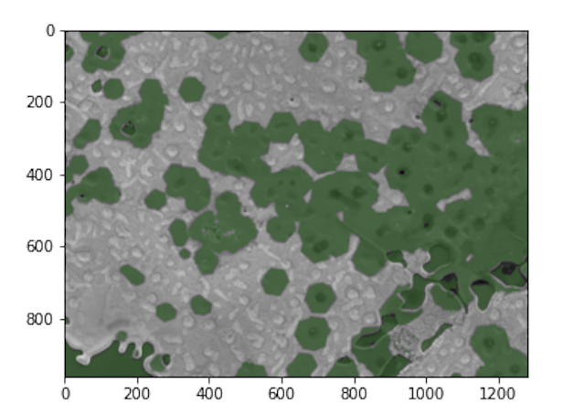
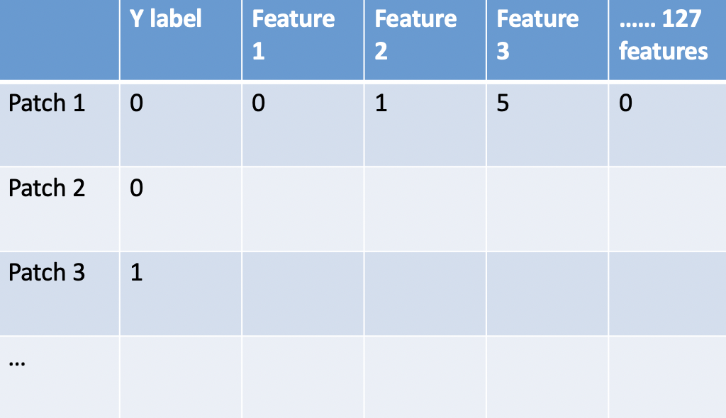
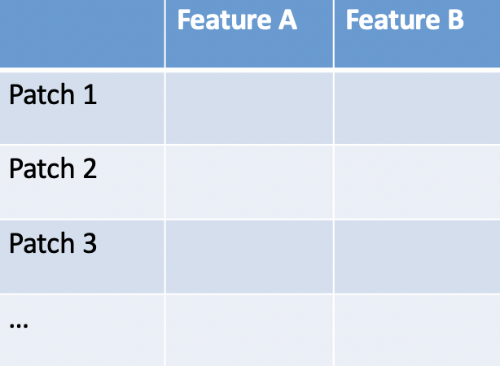
Training Steps
Standardize the features and perform PCA analysis
Fit training result using first 2 PCs to QDA classifier.
Predict results with the classifier and reconstruct predicted image
Show predicted area of graphene as green
Obtain confusion matrix
Notes:
Liu

Slide 9
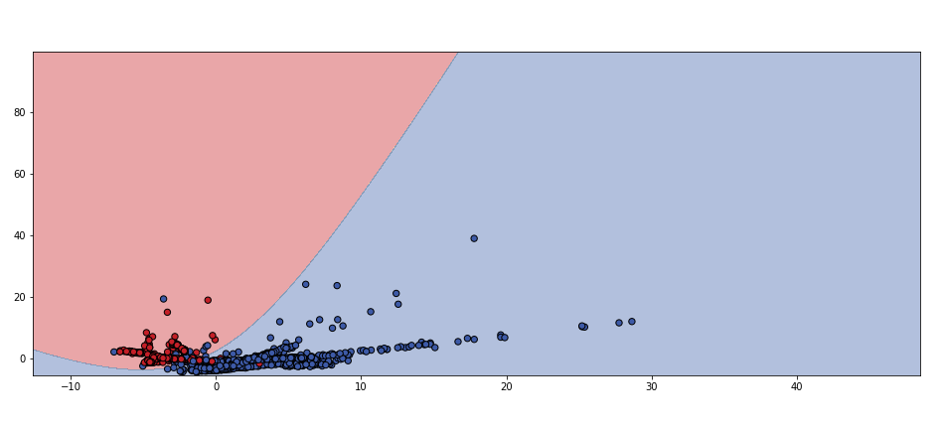
QDA Classifier
Red is graphene; Blue is non-graphene
Notes:
Liu

Slide 10
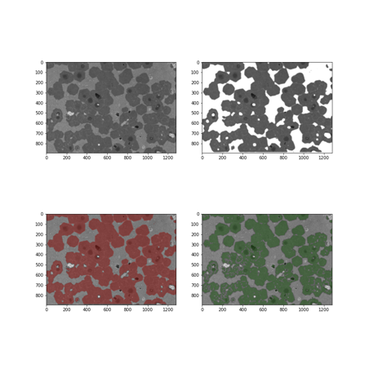
Training 1
 | Pred true | Pred false
True | 0.889 | 0.111
False | 0.025 | 0.975
Raw image
Training result
Masked image
Predict result
Notes:
Tyler

Slide 11
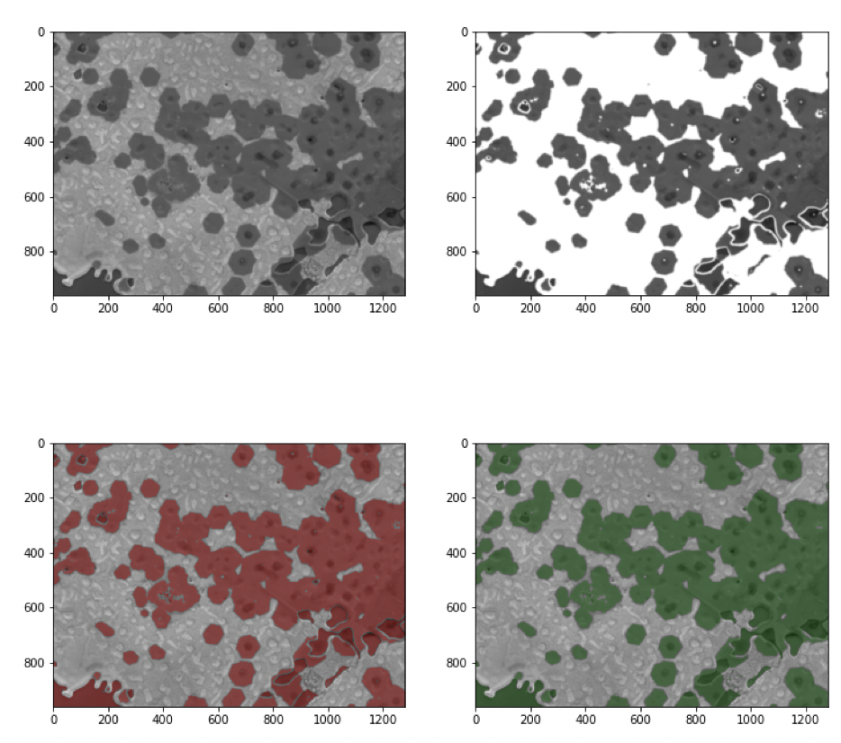
Training 2
 | Pred true | Pred false
True | 1 | 0
False | 0.062 | 0.938
Raw image
Training result
Masked image
Predict result

Slide 12
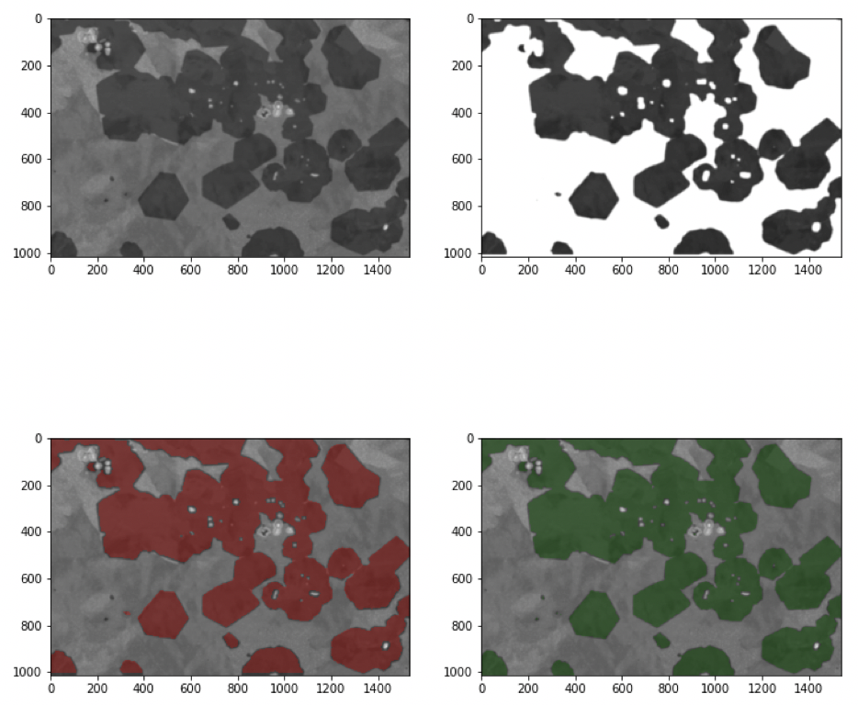
Training 3
 | Pred true | Pred false
True | 0.997 | 0.003
False | 0.054 | 0.946
Raw image
Training result
Masked image
Predict result

Slide 13
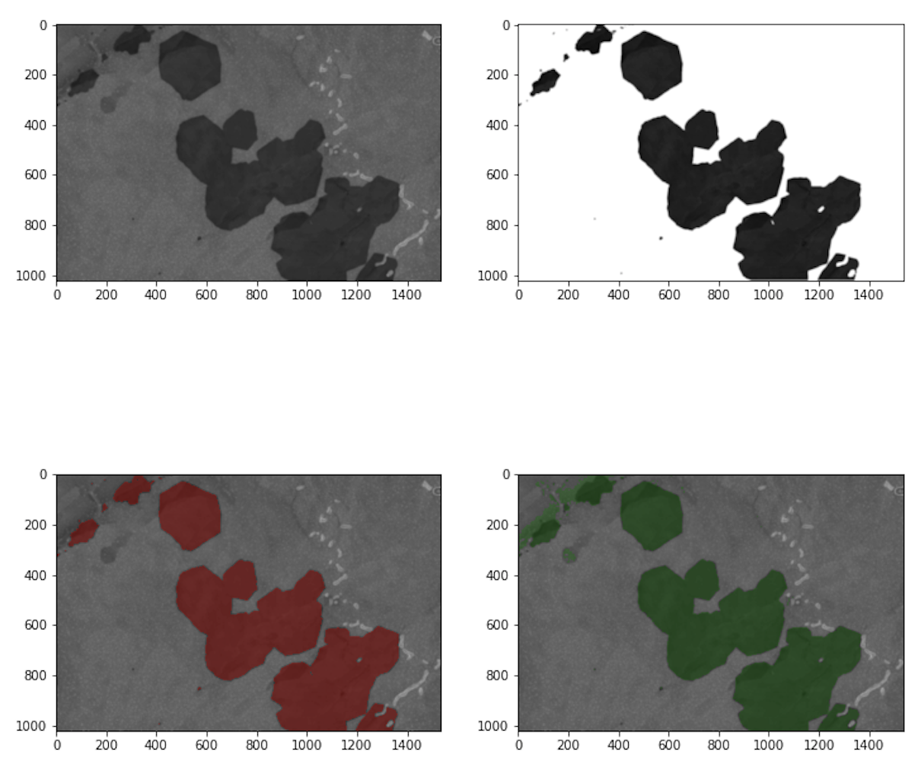
Training 4
 | Pred true | Pred false
True | 1 | 0
False | 0.022 | 0.978
Raw image
Training result
Masked image
Predict result

Slide 14
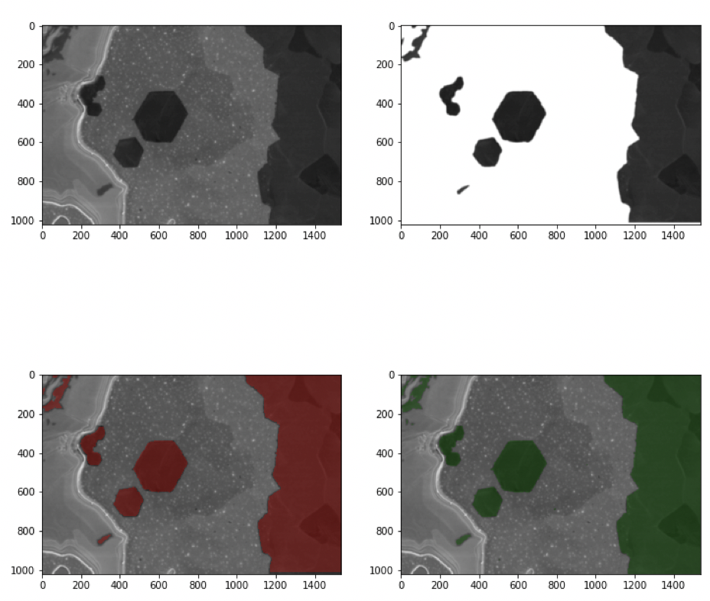
Training 5
 | Pred true | Pred false
True | 1 | 0
False | 0.022 | 0.978
Raw image
Training result
Masked image
Predict result

Slide 15
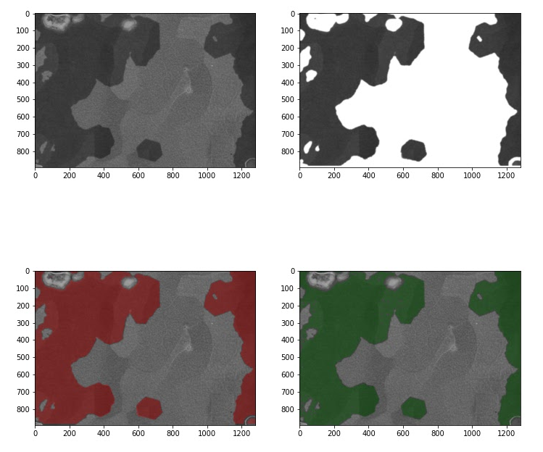
Self Test
 | Pred true | Pred false
True | 0.979 | 0.021
False | 0.013 | 0.987
Raw image
Training result
Masked image
Predict result

Slide 16
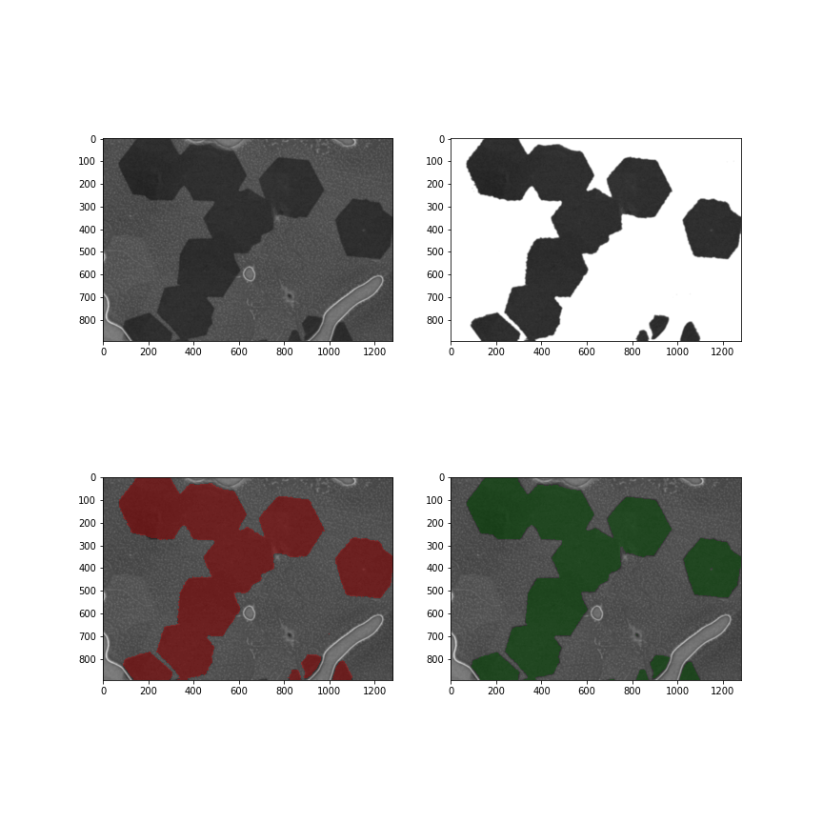
Final Test
 | Pred true | Pred false
True | 0.982 | 0.018
False | 0.003 | 0.997
Raw image
Training result
Masked image
Predict result

Slide 17
Future Work
Overall our model predicts better than the tool provided
Training only takes around 10 seconds after PCA
8x8 patch generation compressed image file and caused information loss during prediction
We could generate more labels than just 0 or 1, to increase predict accuracy, and predict edge of graphene
Notes:
Liu

Slide 18
Questions?

